Slide 1

Smart Car Park Management with License Plate Detection
Guided By
Dr. Balaji Banothu
Presented By
ANKUSH SIKARWAR
MCA
(205121024)
2023
Number Plate Detection using Haar Cascade

Slide 2
Contents
Introduction
Problem Statement
Existing Solution to the Problem And Contribution
Methodology
Graphical Abstract
Implementation
Future Scope
2023
Number Plate Detection using Haar Cascade

Slide 3
Introduction
A technology-driven solution for optimizing parking management.
Utilizes advanced tools like sensors, cameras, and data analytics to improve parking efficiency.
Vehicle Information: Collects information about the vehicles entering and exiting, such as license plate numbers and vehicle types, to enhance security and management
2023
Number Plate Detection using Haar Cascade

Slide 4
Problem Statement
Create an automated Parking Price Management System.
Enable real-time monitoring and adjustment of parking prices.
Implement variable pricing based on factors like location, time, and demand.
2023
Number Plate Detection using Haar Cascade

Slide 5
Existing Solution to the Problem
Manual Entry
Cost Charges
Storage All Data
Limitations about the existing solutions
Time Consuming
Unfair Price Prediction
Locally Data Storage
2023
Number Plate Detection using Haar Cascade

Slide 6
Contribution
Automatic capturing number plate (Time Efficient)
Fair Price Prediction
Reduce The Human Effort
Increase Efficiency of Parking Management

Slide 7
Methodology (Haar Cascade)
Haar cascades, also known as Haar classifiers, are a machine learning object detection method used to identify objects in images or video. They are particularly well-known for their effectiveness in detecting faces and other objects with simple geometric features. Haar Cascade has several features that can make it a strong choice for number plate detection in certain scenarios:
Real-time Processing:
Haar Cascade is optimized for real-time object detection.
It processes images or video frames quickly, ensuring low latency.
Suitable for applications where low latency is crucial, such as Parking management and Traffic management systems.
Capable of easily detecting multiple objects in a single frame.
Haar Cascades can handle variations in lighting, rotation, and scaling, making them suitable for different scenarios
2023
Number Plate Detection using Haar Cascade

Slide 8
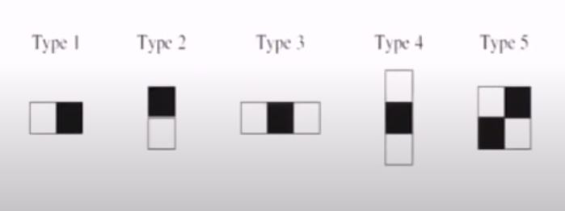
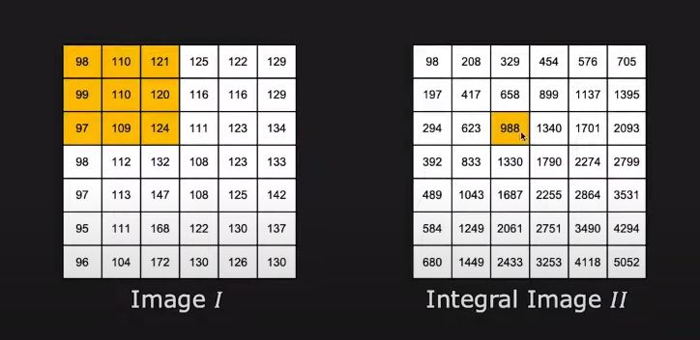
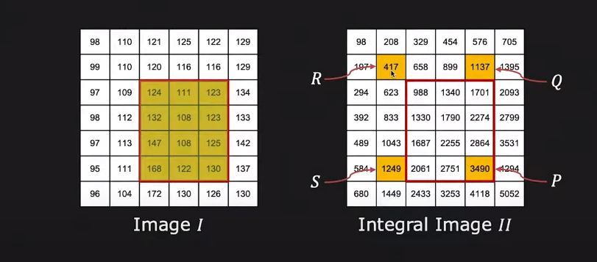
Methodology (Haar Cascade)
Haar-Like Features:
Haar-like features are rectangular areas within an image. These rectangles are placed at different positions and scales to capture various patterns. Compute the difference in the sum of pixel intensities in two adjacent rectangles.
Integral Image:
An integral image, also known as a summed-area table, is a data structure used to efficiently compute the sum of pixel intensities within rectangular regions in an image.
2023
Number Plate Detection using Haar Cascade

Slide 9
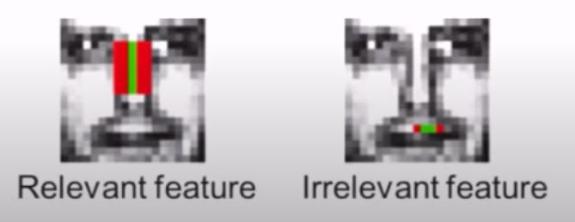
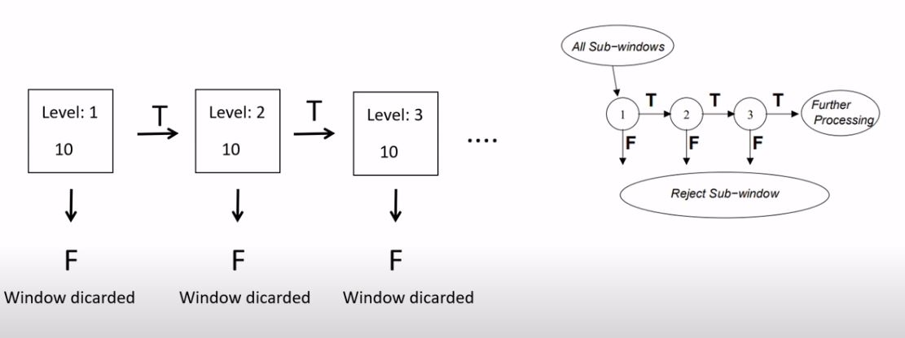
Methodology (Haar Cascade)
Adaboost:
AdaBoost (Adaptive Boosting) is an ensemble learning algorithm that combines multiple weak classifiers to create a strong classifier.
also helps to find best features among the all features.
Cascading:
Cascading refers to the arrangement of multiple classifiers in a hierarchical structure, where each stage progressively refines the classification process.
2023
Number Plate Detection using Haar Cascade

Slide 10
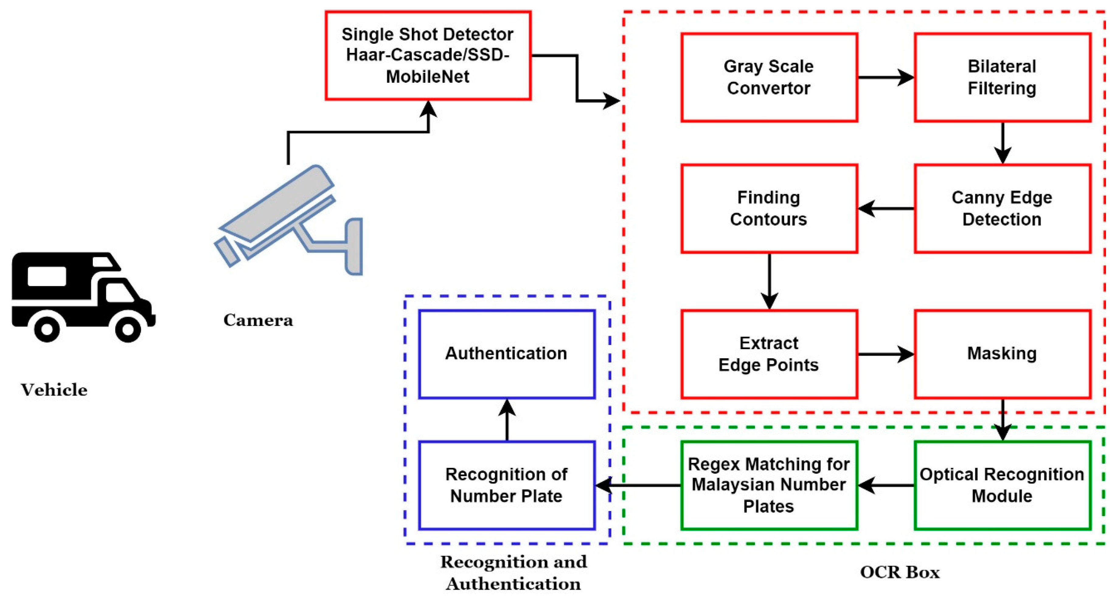
Graphical Abstract
Haar-Cascade
Indian
2023
Number Plate Detection using Haar Cascade

Slide 11
Implementation (Plate Detection)
Input Image/Frame:
Haar Cascade takes an input image or video frame with visible license plate.
Image Preprocessing:
Common preprocessing steps include resizing to a fixed size (e.g., 416x416 pixels).
Convert images to grayscale to simplify feature extraction.
Pixel values are normalized, typically to a range such as [0, 1] or [-1, 1].
Neural Network Backbone:
Initializing a sequential model using keras which allows us to build a convolutional neural network layer by layer.
The network processes the preprocessed image through these layers to extract features at various levels of abstraction.
2023
Number Plate Detection using Haar Cascade

Slide 12
Implementation (Plate Detection)
Finding Contours:
Using contours to recognize the character
After finding contours they are stored in a list as the coordinates.
Prediction based on probability:
Now the model will predict the image which has been cropped from the original image.
After that it will recognize the character based on probability it will classify the different text.
Output:
The final output is a appended in a list, which is of length 10 or 9.
2023
Number Plate Detection using Haar Cascade

Slide 13
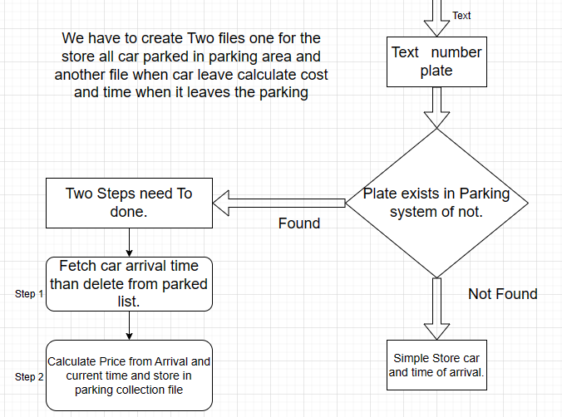
Parking Price Calculation

Slide 14
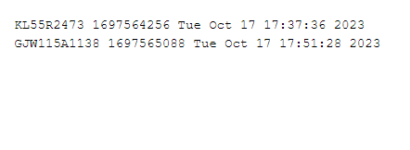

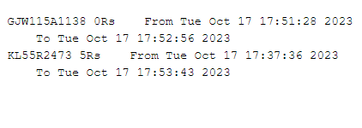

Store These Calculation

Slide 15
Future Scope
According to parked Car Automatic Price Deduct From Your Account
Cashless System for Parking Price Deduction.
Reduce Human Effort To Track All Vehicles.

Slide 16
Thank You

